Slide 1
HOPFIELD NETS
IMAGE PROCESSING
GROUP PRESENTATION
Krishna Chauhan
Bidish Acharya
Anil Lama
Sameer Koirala

Slide 2
CONTENT
INTRODUCTION
PROPERTIES OF HOPFIELD NETWORK
ALGORITHM
ALGORITHM APPLICATION
IMAGE PROCESSING APPLICATION

Slide 3
INTRODUCTION
Hopfield neural network is proposed by John Hopfield in 1982 AD
  It can be seen as a network with associative memory
  It can be used for different pattern recognition problems

Slide 4
INTRODUCTION
It is a fully connected, single layer auto associative network
  Means it has only one layer, with each neuron connected to every other neuron
All the neurons act as input and output.

Slide 5
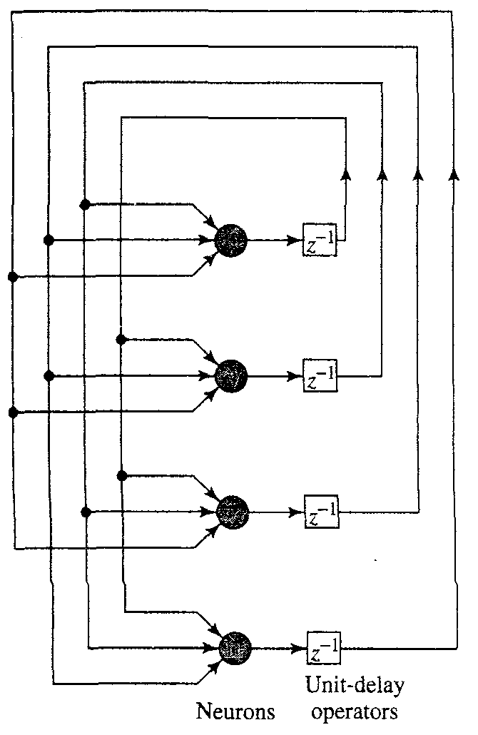
INTRODUCTION
The Hopfield network(model) consists of
a set of neurons and
corresponding set of unit
delays, forming a multiple
Loop feedback system as
shown in fig

Slide 6
INTRODUCTION
The number of feedback loops is equal to the number of neurons.
Basically, the output of the neuron is feedback, via a unit delay element, to each of the other neurons in the network.
  no self feedback in the network.

Slide 7
PROPERTIES OF HOPFIELD NETWORK
A recurrent network
  Feedback from output to input
Nodes have binary outputs
  Either 0, 1 or -1, 1
Symmetric Connections
  Connection weights from unit i to unit j and from unit j to unit i are identical for all i and j

Slide 8
PROPERTIES OF HOPFIELD NETWORK
No connection from a node to itself is allowed.
Nodes are updated asynchronously
  i.e. nodes are selected at random.
The network has no hidden nodes or layer.

Slide 9
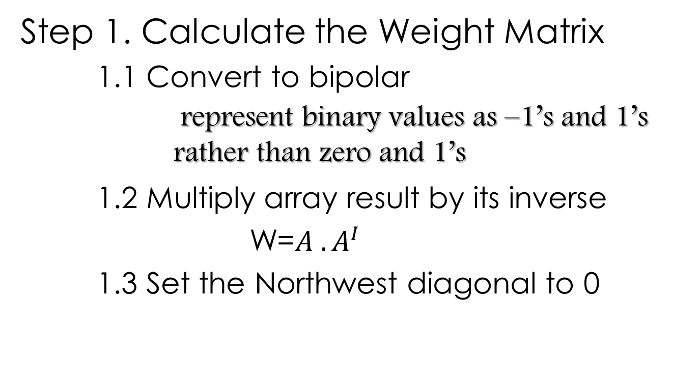
ALGORITHM

Slide 10
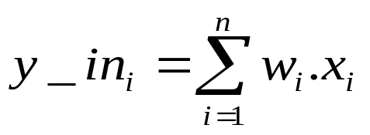
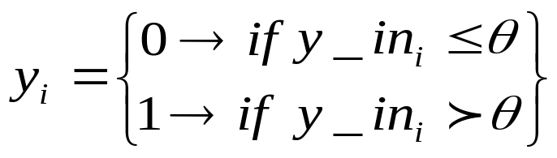

ALGORITHM
Step 2. Compute net input:
Step 3. Determine activation (output signal):
  is the threshold which is usually any value greater than zero.

Slide 11
ALGORITHM
If output pattern matches input pattern then pattern is recognized

Slide 12

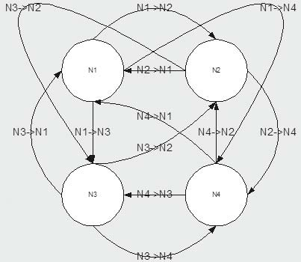
ALGORITHM APPLICATION
Connection of Hopfield Neural Network
A Hopfield Neural network:
 | Neuron 1 (N1) | Neuron 2 (N2) | Neuron 3 (N3) | Neuron 4 (N4)
Neuron 1 (N1) | (N/A) | N2->N1 | N3->N1 | N4->N1
Neuron 2 (N2) | N1->N2 | (N/A) | N3->N2 | N4->N2
Neuron 3 (N3) | N1->N3 | N2->N3 | (N/A) | N4->N3
Neuron 4 (N4) | N1->N4 | N2->N4 | N3->N4 | (N/A)

Slide 13
ALGORITHM APPLICATION
Step 1.1: Convert 0101 to bipolar
0 = -1
1 = 1
0 = -1
1 = 1
The final result is the array (-1, 1, -1, 1)

Slide 14


ALGORITHM APPLICATION
Step 1.2: Multiply (-1, 1, -1, 1) by its Inverse
For this step we will consider -1, 1, -1, 1 to be a matrix.
Taking the inverse of this matrix we have.

Slide 15
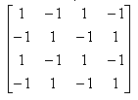
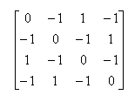
ALGORITHM APPLICATION
And the matrix is:
        W=
Step 1.3: Set the Northwest diagonal to zero
        W=

Slide 16
ALGORITHM APPLICATION
Step 2. Compute net input:
      [0 1 0 1] *
 | a | b | c | d | Y_in (a+b+c+d)
N1 | 0 | -1 | 0 | -1 | -2
N2 | 0 | 0 | 0 | 1 | 1
N3 | 0 | -1 | 0 | -1 | -2
N4 | 0 | 1 | 0 | 0 | 1

Slide 17
ALGORITHM APPLICATION
Step 3. Determine activation (output signal):
N1 y_in is –2, would not fire (y=0)
N2 y_in is 1, would fire (y=1)
N3 y_in is –2, would not fire(y=0)
N4 y_in is 1 would fire (y=1).

Slide 18
ALGORITHM APPLICATION
The final binary output from the Hopfield network would be 0101.
Pattern matches so pattern is recognized

Slide 19
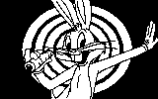
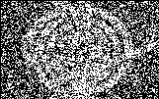
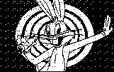
IMAGE PROCESSING APPLICATION
Image Detection and Recognition
In Medical Image Restoration

Slide 20
REFERENCE
SLIDESHARE.NET

Slide 21

ANY QUESTIONS?????????

